Slide 1
Malignant tumors of uterus
Dr Rasika herath
Department of Obstetrics and Gynaecology

Slide 2
Objectives
To identify the risk factors and associations of endometrial malignancy
Recognize clinical presentation of endometrial malignancy
To describe the evaluation of a woman post menopausal/peri menopausal bleeding
To describe treatment of endometrial malignancy
To describe prognostic factors of endometrial malignancy
To have an overview of endometrial sarcoma

Slide 3
Endometrial Carcinoma
A common gynaecological malignancy
Disease of postmenopausal women
(>90%), mean age is 61 yrs.
Rare before 40 yrs. <5% (2/100,000)

Slide 4
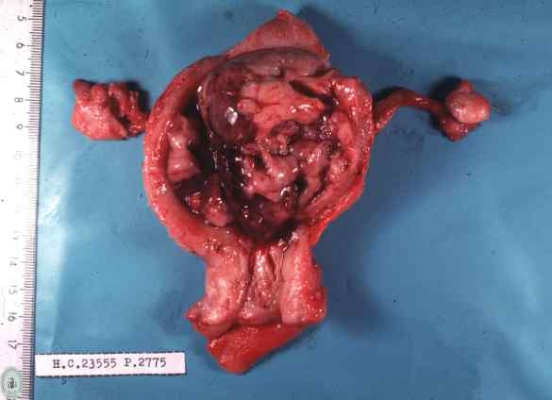
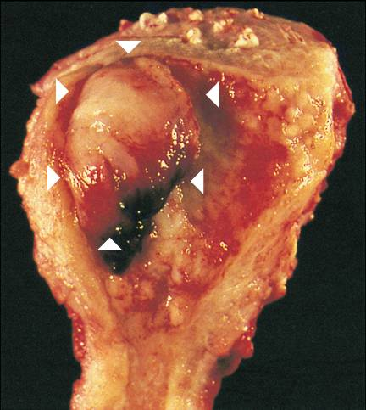
Endometrial cancer

Slide 5
Etiology of endometrial CA
High level of estrogen or prolonged estrogen influence
excessive endogenous estrogen
exogenous estrogen
Hereditary predisposition

Slide 6
How does Estrogen cause Endometrial CA?
Unopposed Estrogen causes endometrial hyperplasia
With high rate of cell turnover, DNA repair process might fail; apoptosis also fail; cells with malignant potential escape surveillance & grow.

Slide 7
Exogenous Estrogen
Hormone replacement therapy
Unopposed estrogen activity
Estrogen only HRT
Tamoxifen
SERM

Slide 8
Endogenous Estrogen
Anovulation with PCOS
Cirrhosis of the liver
Obesity
Increased peripheral conversion
Estrogen secreting tumours
Ovarian, adrenal

Slide 9
PCOS and endometrial CA
Anovulation - continuous estrogen dominant proliferative phase
Hyperinsulinaemia

Slide 10
Endometrial hyperplasia
Malignancy Risk
Hyperplasia without atypia <5% over 20 years
Atypical hyperplasia 8%
2014 WHO classification

Slide 11
Hereditary predisposition & Endometrial CA
Lynch syndrome – HNPCC
Life time risk
Colorectal - 40%
Endometrial - 50%
Ovarian - 10%
Gastric - 5 %
Biliary -15%
Urinary - 5%

Slide 12
Other associations
Obesity- endometrioid type and earlier at diagnosis
Diabetes
High socio-economic state
Nullipara
Early menarche
Late menopause

Slide 13
Factors that reduce the risk of endometrial carcinoma
Physical activity
Long term use of continuous combined oestrogen-progestin therapy
Progestin based contraceptives
Pregnancy
LNG- IUS

Slide 14
Classification
Two cohorts of endometrial malignancies
Type 1
Type 2

Slide 15
characteristics | Type 1 | Type 2
 | Grade 1 and 2 endometrioid carcinoma | Grade 3 endometrioid carcinoma and non endometrioid histology
 | Most common | Least common
Age | 55-65 years | 65-75 years
Clinical setting | Unopposed estrogen Obesity HT DM | Atrophy Thin physique
Morphology | endometrioid | Serous Clear cell Mix mullerian tumor
precursor | Atypical hyperplasia
Behavior | Indolent Spread via lymphatics | Aggressive Intraperitoneal and lymphatics spread
 | Good prognosis | Poor prognosis

Slide 16
Presentation
PMB (Post menopausal bleeding)
5% of women with PMB have a sinister pathology
Vaginal discharge or pyometra
Irregular vaginal bleeding.
Pelvic pain.
Symptoms due to metastases.
(Haematuria, PR bleeding..)

Slide 17
Examination
Obesity - BMI.
Signs of PCOD
LN- supraclavicular, inguinal
Vaginal metastasis.
Enlarged uterus
Adnexal or, parametrial involvement

Slide 18
Investigations
Trans vaginal scan
Endometrial sampling
MRI to assess the spread
Other investigations to assess the fitness for surgery
CT-IVU if ureteric obstructions are suspected

Slide 19
Investigations
Trans vaginal scan
Endometrial thickness (> 4-5m)
Irregular endometrial outline
Fluid in the cavity
Ovaries
primary tumours secreting estrogen
secondary deposits
In a woman with post menopausal bleeding, if the ET is <4mm Endometrial malignancy is unlikely

Slide 20
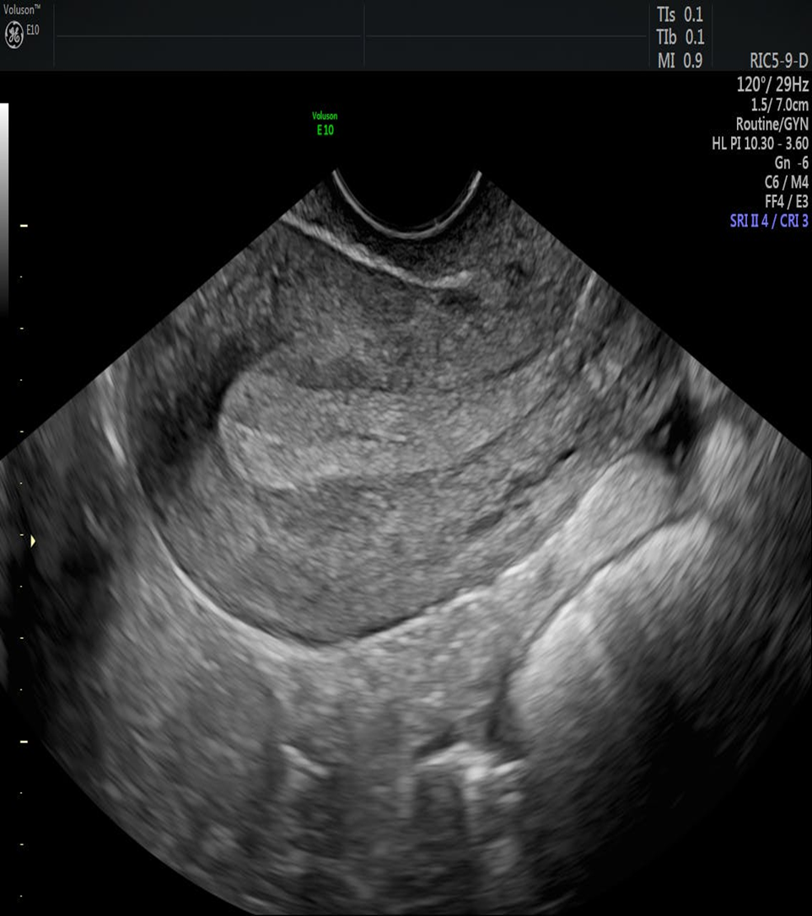
USS- secretory phase endometrium

Slide 21
Investigations
MRI
Better than USS and CT to detect
Myometrial involvement
Cervical involvement
Pelvic lymph nodes

Slide 22
Endometrial sampling
Hysteroscopy(Gold standard)
Examination of the endometrial cavity with a camera
In patient / outpatient
Visualization of polyp/ fibroid/growth
Directed biopsy
As office procedure / Under SA/ under GA
Expensive
Needs expensive instruments and expertise

Slide 23
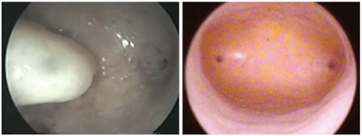
Hysteroscopy
Hysteroscopy has a sensitivity and specificity for identifying endometrial cancer of 86% and 99%, respectively.

Slide 24
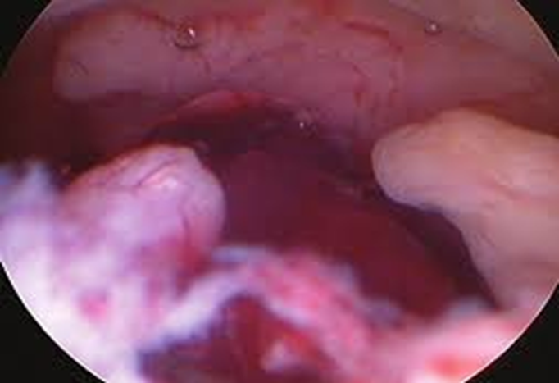
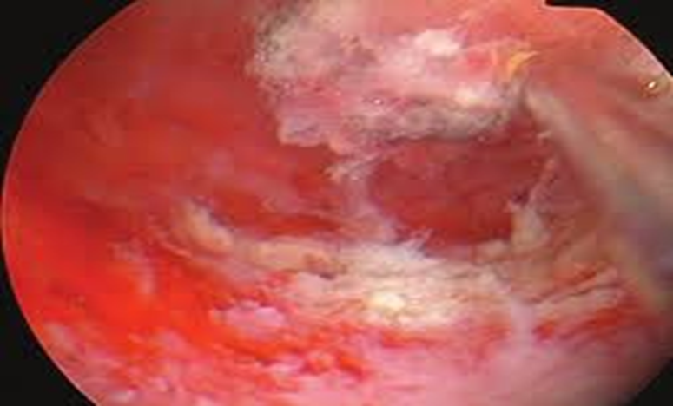
Atypical endometrial hyperplasia in hysteroscopic view
Endometrial adenocarcinoma in hysteroscopic view: a cluster of polypoid projections

Slide 25
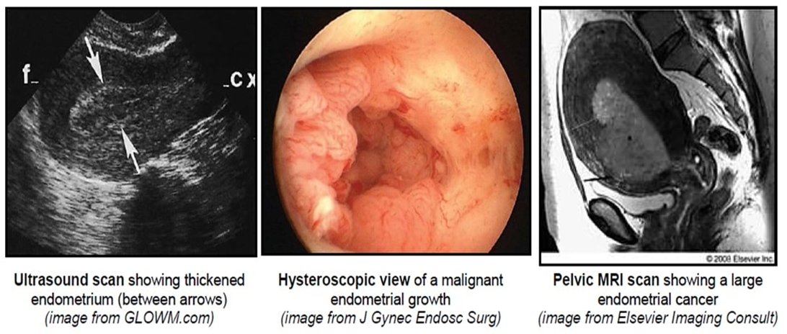

Slide 26
Endometrial sampling
Endometrial aspiration
Small tube will be passed through the cervix and aspirate endometrial tissues
Simple outpatient procedure
No need of anaesthesia
Cheap, less skills and training needed

Slide 27
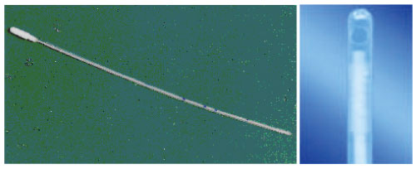
Endometrial Pipell sampling
The Pipell© biopsy instrument is a fine-bore plastic instrument with a curette-like tip and a central plunger, which creates a vacuum when pulled.
has a sensitivity and specificity of 68–81% and 99–100% for identifying endometrial hyperplasia and endometrial cancer

Slide 28
Endometrial sampling
Dilatation and Curettage
Method of obtaining a sample of endometrium under anesthesia
Blind procedure
Useful if endometrial aspiration is impossible and hysteroscopy is not available

Slide 29
Histological subtypes in endometrial cancer
Type | % of cases
Endometrioid adenocarcinoma | 50-60
Adenosquamous | 6-8
Serous papillary | 18
Sarcomas/leiomyosarcomas | 3-5
Carcinosarcomas | 2-3
Clear cell | 1-6

Slide 31
Overall 5 year survival of Endometrial malignancy
All together - 75%
Papillary - 30%
Clear cell - 40%

Slide 32
5 Year survival according to stage of the disease
stage | 5 – year survival (%)
I | 88
II | 75
III | 55
IV | 16

Slide 33
Prognostic factors of endometrial CA
Stage
Depth of Myometrial invasion/cervical stromal invasion
Degree of differentiation
Ploidy status
Tumour size
Histological sub types
Lymphovascular invasion
Age

Slide 34
Management of endometrial carcinoma
Surgery
Radiotherapy
Progesterone
Chemotherapy

Slide 35
Surgery - Endometrial CA
TAH and BSO (or Laparoscopic) ± pelvic Lymphadenectomy
Adnexal removal is recommended even if the tubes and ovaries appear normal, as they may contain micro metastases.
In premenopausal women with low-grade early stage disease, ovarian preservation could be considered.

Slide 36
Surgery - Endometrial CA
Where obvious cervical stromal involvement is demonstrated preoperatively, a modified radical hysterectomy
Lymphadenectomy is indicated if
high grade
Invasion >50% of the myometrium
Virulent histological type

Slide 37
Surgery for endometrial CA operative technique
Sub umbilical midline incision
Peritoneal cytology (around uterus, bladder, POD )
Thorough search of peritoneal cavity
( uterine, adenexae, retroperitoneal nodes, Omentum, liver )
Proceed with surgery – uterus is cut open & see invasion > ½; if lymphadenectomy is considered

Slide 38
Management Stage I
TAH + BSO
± pelvic lymphadenectomy
In high risk for LN involvement
>grade 2
>1/2 myometrium involved
Serous & clear cell

Slide 39
Radiotherapy & Endo-CA stage I
Evidence
No survival advantage
But vault brachytheraphy - reduce vault recurrence
Teletheraphy – reduce pelvic recurrence.
No radiotherapy necessary in women under 60 yrs, stage 1 ( < 50% myometrial invasion) with grade 1 or 2 ( ASTEC trial)

Slide 40
Stage II - surgery + post-op radiotherapy
Radical hysterectomy+ BSO + Omentectomy+ Pelvic lymphadenectomy selective aortic node dissection
Post-op radiotherapy to vault

Slide 41
Stage III - Management
Complete surgical resection of all pelvic and/or nodal disease and postoperative EBRT and/or chemotherapy
Or
Radical Radiotherapy

Slide 42
Stage - IV
Common site - lung
Primary aim is palliation

Slide 43
Radio therapy and endo metrial CA
Post operative;
To sterilize LN
To prevent vaginal vault recurrence
Types;
Intracavitatory
External beam (EBRT)

Slide 44
Progesterone & endometrial CA
Stage IV Endometrial CA
Recurrent Endometrial CA
Read

Slide 45
Recurrence
50% recurrence occur within 2 years of treatment.
Most common site of extra pelvic metastasis is lungs.
Isolated vaginal recurrence has the best prognosis.
Late recurrence – treated with progesterone

Slide 46
Uterine sarcoma
Account for 3% (Rare) of uterine malignancies.
15% all deaths from uterine cancer.
Usually rapidly growing tumour with poor prognosis

Slide 47
Leiomyosarcoma
1/3 of uterine sarcomas are leiomyosarcomas.
Present with postmenopausal bleeding, irregular vaginal bleeding, vaginal discharge, abdominal or pelvic pain, weight loss or abnormal cytology.
Should suspect in women withrapidly growing uterine mass or fibroid uterus.

Slide 48
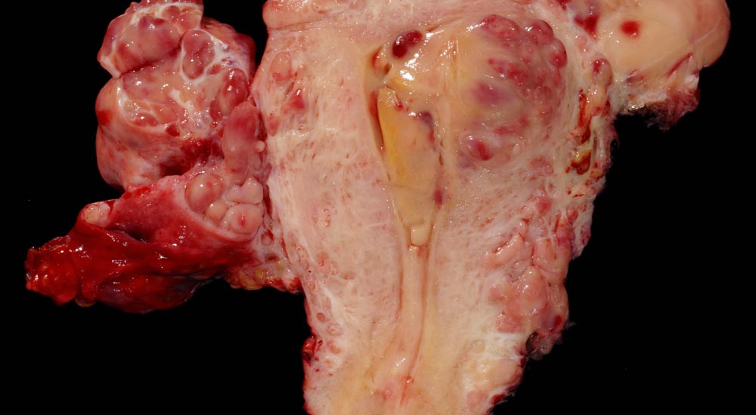
Uterine stromal sarcoma

Slide 49
In summary
Women with PMB should be investigated to exclude a malignancy
TVS should be done to assess endometrial thickness
ET > 4mm should have a endometrial biopsy
TAH + BSO (or laparoscopic) is the treatment of low grade, early stage disease

Slide 50
THANK YOU

